Slide 1


Green Pace
Security Policy Presentation
Developer: Daniel Coffey

Slide 2

OVERVIEW: DEFENSE IN DEPTH
Defense in Depth (DiD) is an approach to cybersecurity in which a series of defensive mechanisms are layered in order to protect valuable data and information.
If one mechanism fails, another steps up immediately to prevent an attack.
This multi-layered approach with intentional redundancies increases the security of a system as a whole and addresses many different attack vectors.

Slide 3
THREATS MATRIX
The threat matrix can be utilized to prioritize threats.
The order of urgency goes from priority, to likely, to low priority, and finally to unlikely.
10 Standards:
5 – Likely
3 – low priority
2 – unlikely
Likely STD-003-CPP STD-004-CPP STD-005-CPP STD-009-CPP STD-010-CPP | Priority Require immediate attention
Low priority STD-002-CPP STD-007-CPP STD-008-CPP | Unlikely STD-001-CPP STD-006-CPP

Slide 4
10 PRINCIPLES
1. Do not cast an out-of-range enumeration value
2. Do not rely on the value of a moved from object
3. Do not attempt to create a std::string from a null pointer
4. Do not store already-owned pointer value in an unrelated smart pointer
5. Do not access freed memory
6. Use a static assertion to test the value of a constant expression
7. Do not let exceptions escape from destructors and deallocation functions
8. Store a new value in pointers immediately after free()
9. Be careful when using functions that use file names for identification
10. Do not make assumptions about the size of an environment variable

Slide 5
CODING STANDARDS
1. Validate Input Data
2. Heed Compiler Warnings
3. Architect and Design for Security Policies
4. Keep it Simple
5. Default Deny
6. Adhere to the Principle of Least Privilege
7. Sanitize Data Sent to Other Systems
8. Practice Defense in Depth
9. Use Effective Quality Assurance Techniques
10. Adopt a Secure Coding Standard

Slide 6
ENCRYPTION POLICIES
Encryption in flight – Encrypting data in-flight means that you encrypt data when it’s being transmitted over a network. Regarding some applications, data that is in rest may be unencrypted, but it gets encrypted while it is being communicated to provide proper defense.
Encryption at rest – Encrypting the data on the disk. Encryption at rest is designed to prevent the attacker from accessing the unencrypted data by ensuring the data is encrypted when on disk. If an attacker obtains a hard drive with encrypted data but not the encryption keys, the attacker must defeat the encryption to read the data.
Encryption in use – Compromising data in use enables access to encrypted data at rest and data in motion. For example, someone with access to random access memory can parse that memory to locate the encryption key for data at rest. Once they have obtained that encryption key, they can decrypt encrypted data at rest.

Slide 7
TRIPLE-A POLICIES
Authentication is the process of verifying one’s identity, and it takes place when subjects present suitable credentials to do so. When a user enters the right password with a username, for example, the password verifies that the user is the owner of the username. Essentially, authentication establishes the validity of a claimed identity.
Authorization is a security technique for determining a user’s privileges or eligibility to execute specific tasks in a system. The authorization procedure specifies the role-based powers a user can have in the system after they have been authenticated as an eligible candidate.
Accounting monitors the resources a user consumes during network access. This can include the amount of system time, or the amount of data sent and received during a session.

Slide 8
Unit Testing
Unit Test Names: Define all unit test names to appropriately reflect the test condition.
Unit Testing: Successfully implement the 13 unit tests, as part of the Google Test fixture; run Google Test ASSERT and EXPECT functionality to prove the tests. Each test you run must explicitly prove the defined condition of the test.
Negative Unit Tests: Complete at least 2 of the unit tests as negative tests that demonstrate capturing the appropriate unit test result based on an expected negative result of the test code.
C/C++ Program Functionality and Best Practices: Demonstrate industry standard best practices, including in-line comments and appropriate naming conventions to enhance readability of code. Develop functional C/C++ code that illustrates a software design pattern approach.

Slide 9
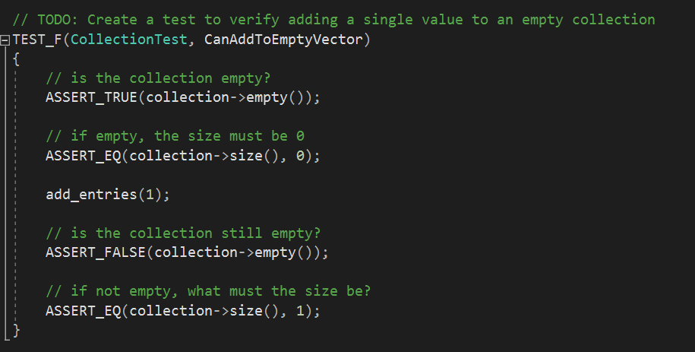

Slide 10
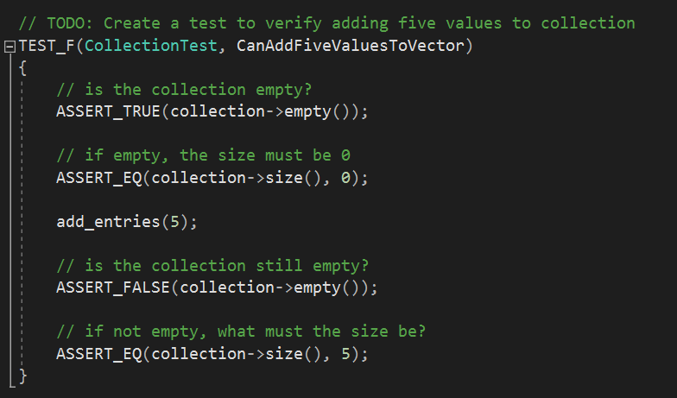

Slide 11
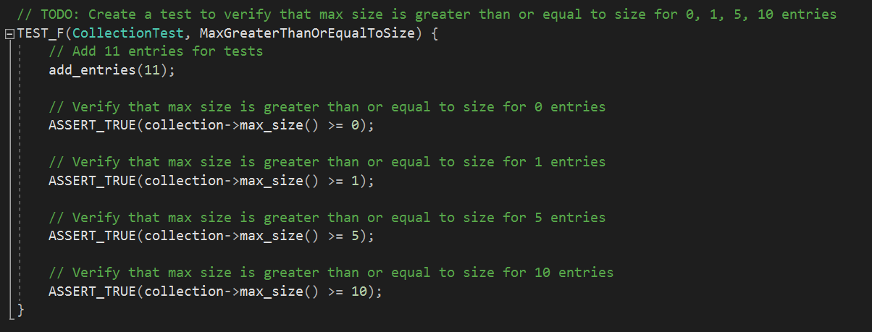

Slide 12
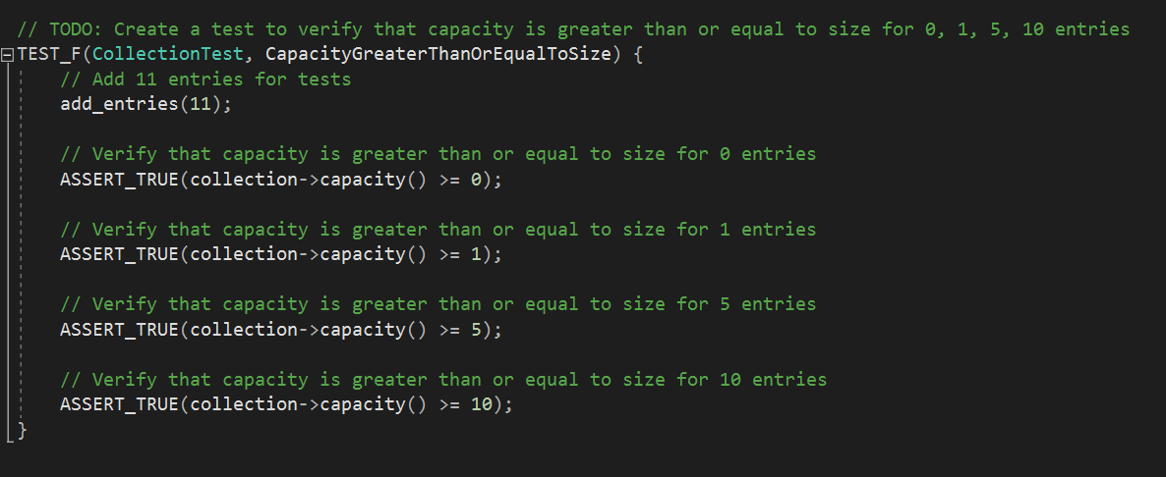

Slide 13
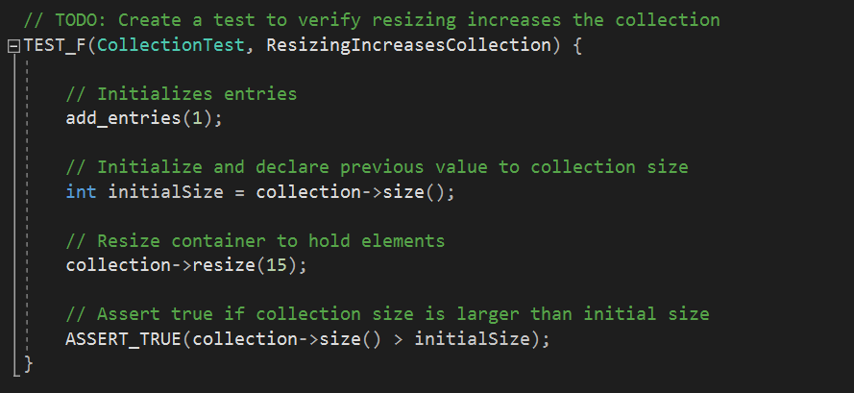

Slide 14
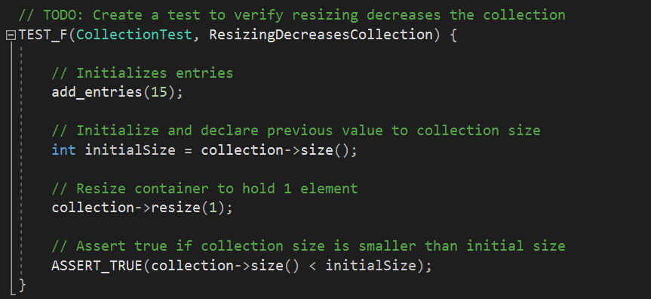

Slide 15
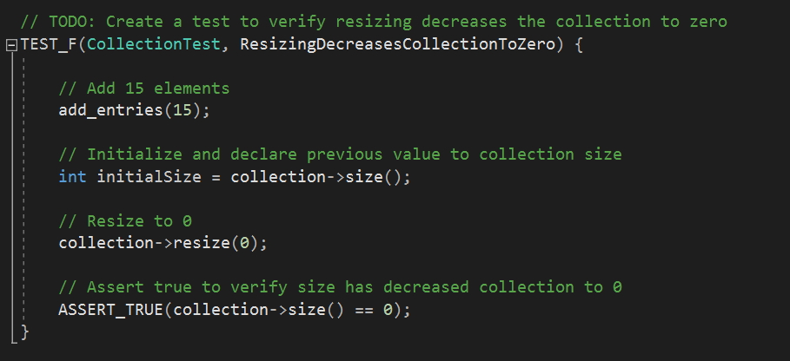

Slide 16
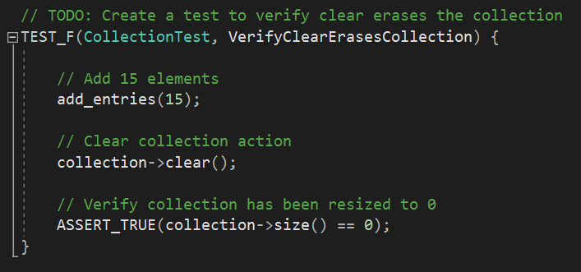

Slide 17
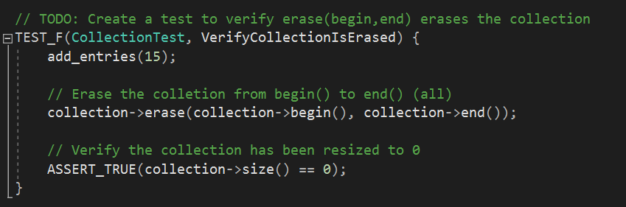

Slide 18
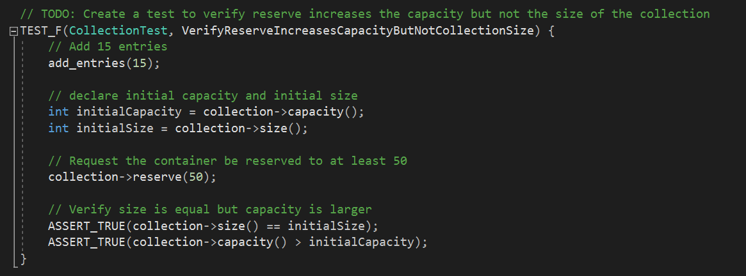

Slide 19
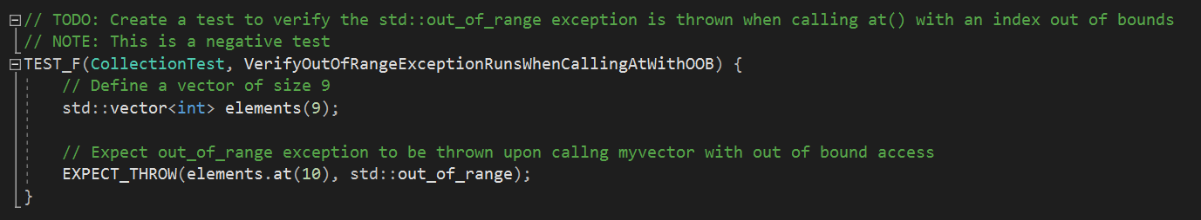

Slide 20
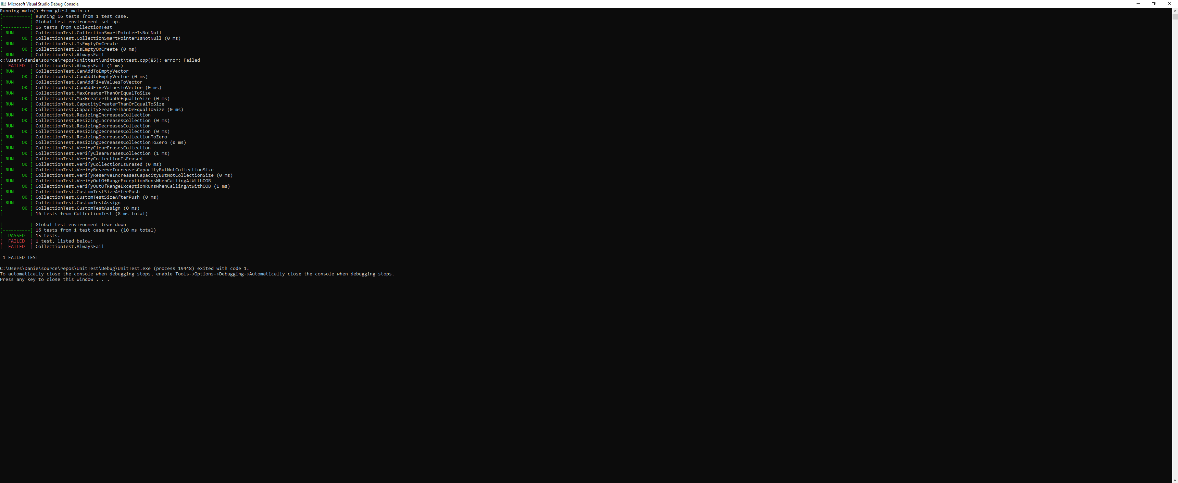
Unit Test

Slide 21

AUTOMATION SUMMARY

Slide 22
TOOLS
DevSecOps Pipeline refers to integrating security into your software development life cycle.
Phases and tools utilized:
Plan – Jira Software for tracking and management and Slack for communication
Code – Security tools such as Gerrit, Phabricator, SpotBugs, PMD, CheckStyle, and Find Security Bugs
Build – OWASP Dependency-Check, SonarQube, SourceClear, Retire.jsm Checkmarx, and Snyk.
Test – BDD Automated Security Tests, JBroFuzz, BooFuzz, OWASP ZAP, Arachi, IBM AppScan, GAUNTLT, and SecApp suite
Release – Principle of least privilege & configuration management tools such as Ansible, Puppet, HashiCorp Terraform, Chef, and Docker.
Deploy – Runtime verification tools such as Qsquery, Falco, and Tripwire, which can extract information from a running system in order to determine whether it performs as expected.
Ongoing Security – Runtime Defense tools such as Imperva RASP, Alert Logic, and Halo

Slide 23
RISKS AND BENEFITS
Risks
Too many layers can add complexity
Need expertise
Can be costly both financially and with time
Benefits
Preventative
Early Identification and elimination can be less costly than having to fix damage from an attack
Offers secure protection from attackers

Slide 24
RECOMMENDATIONS
Adhere to our proactive security model
Leverage industry groups for standards support
Make use of the tools provided to catch and prevent any problems early
Keep monitoring for any chances or new threats
Follow the Defense in Depth module
Make use of:
The 10 Principles
The 10 Standards
Encryption
In Rest
At Flight
In Use
Triple-A Framework
Authentication
Authorization
Accounting

Slide 25
CONCLUSIONS
Coding Standards that should be adopted to prevent future problems
1. Validate Input Data
2. Heed Compiler Warnings
3. Architect and Design for Security Policies
4. Keep it Simple
5. Default Deny
6. Adhere to the Principle of Least Privilege
7. Sanitize Data Sent to Other Systems
8. Practice Defense in Depth
9. Use Effective Quality Assurance Techniques
10. Adopt a Secure Coding Standard
Also, utilize the 10 Principles, the Threats Matrix, the Encryption Policies, the Triple-A Policies, Automation Monitoring, and The Tools provided.

Slide 26
REFERENCES
A. (2021, October 20). Identification, Authentication, Authorization - What’s The Difference. Imageware. Retrieved February 20, 2022, from https://imageware.io/identification-authentication-authorization-difference/
Atlassian. (n.d.). DevSecOps Tools. Retrieved February 20, 2022, from https://www.atlassian.com/devops/devops-tools/devsecops-tools
Barnum, S. B. (2005, September 13). Defense in Depth | CISA. Cybersecurity & Infrastructure Security Agency. Retrieved February 21, 2022, from https://www.cisa.gov/uscert/bsi/articles/knowledge/principles/defense-in-depth#:%7E:text=Defense%20in%20depth%20helps%20reduce,Never%20give%20up.
DeTerra, K. D. (2021, February 9). Automation, Security, and Defense in Depth. Extreme Networks. Retrieved February 20, 2022, from https://www.extremenetworks.com/extreme-networks-blog/automation-security-and-defense-in-depth/#:%7E:text=Defense%20in%20Depth%20and%20Continuous%20Monitoring&text=Research%20tells%20us%20that%20when,more%20damage%20they%20can%20do.&text=A%20defense%20in%20depth%20strategy%20is%20to%20use%20automation%20to,unexpected%20changes%20in%20the%20configurations.
Microsoft. (2022, January 3). Azure Data Encryption-at-Rest - Azure Security. Microsoft Docs. Retrieved February 20, 2022, from https://docs.microsoft.com/en-us/azure/security/fundamentals/encryption-atrest#:%7E:text=Encryption%20at%20rest%20is%20designed,encryption%20to%20read%20the%20data.
Risk Assessment - SEI CERT Perl Coding Standard - Confluence. (n.d.). Confluence. Retrieved February 20, 2022, from https://wiki.sei.cmu.edu/confluence/display/perl/Risk+Assessment
Seacord, R. S. (2018, May 2). Top 10 Secure Coding Practices - CERT Secure Coding - Confluence. Confluence. Retrieved February 20, 2022, from https://wiki.sei.cmu.edu/confluence/display/seccode/Top+10+Secure+Coding+Practices
What Is AAA? (n.d.). ArubaNetworks. Retrieved February 20, 2022, from https://www.arubanetworks.com/techdocs/ClearPass/6.7/Aruba_DeployGd_HTML/Content/802.1X%20Authentication/About_AAA.htm#:%7E:text=AAA%20stands%20for%20authentication%2C%20authorization,necessary%20to%20bill%20for%20services.
What is Defense in Depth? (2021, May 6). Forcepoint. Retrieved February 20, 2022, from https://www.forcepoint.com/cyber-edu/defense-depth
Wikipedia contributors. (2021, December 29). Data in use. Wikipedia. Retrieved February 20, 2022, from https://en.wikipedia.org/wiki/Data_in_use#:%7E:text=Compromising%20data%20in%20use%20enables,decrypt%20encrypted%20data%20at%20rest.

